Slide 1

CMSI 402 Presentation
Andrew Won
2013 May 9

Slide 2
ShopLifter – Project Goals
An integration exercise
RESTful web service with HTTP and URI contracts
Database-driven (SQL) inventory management
JavaScript front end and Java back end architecture
Better understand web technology

Slide 3
ShopLifter – Description
Target Audience: Small business owners looking to start their own e-commerce web site, but not looking to spend money on more expensive, monthly-paid solutions.
Content Management System web application that can be launched from any major browser
Graphical User Interface
“Code-less” web page creation and editing
Persistent inventory management
Sales and business report generation

Slide 4
ShopLifter – User Scenarios
Arrive at dashboard
Edit services/items through a table
Add services/items through a form
Select Manage Inventory
Designate pages for services/items to appear on
User – Managing Saleable Services/Items
Arrive at dashboard
View list of available reports/proposals
Click button to generate
Select Generate Reports / Invoices
(Optionally) Edit template of report
User – Generating Reports/Proposals
Arrive at dashboard
View list of Customer Front-End Pages and Templates
Save Page
Select Edit Customer Web Site
(Optionally) Edit Customer Front-End page/template by WYSIWYG Editor
User – Edit the Customer Front-End

Slide 5
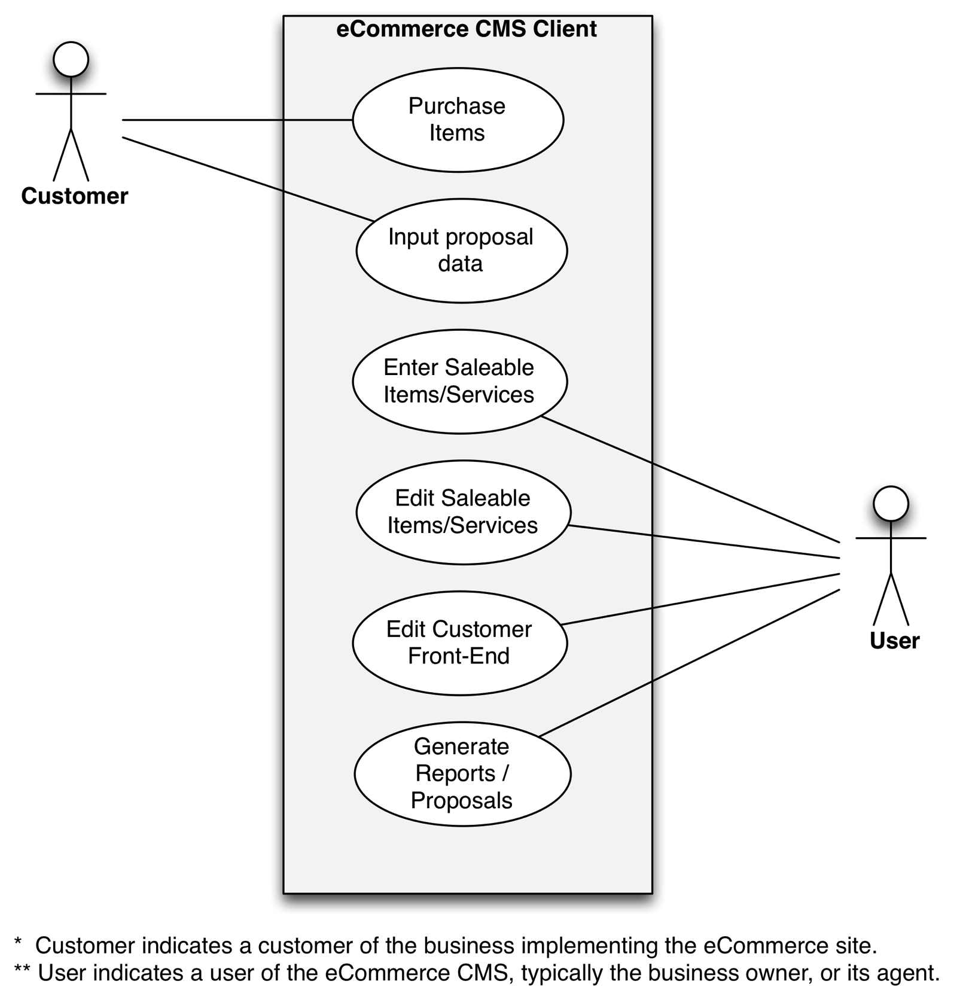
ShopLifter – Client Use Cases

Slide 6
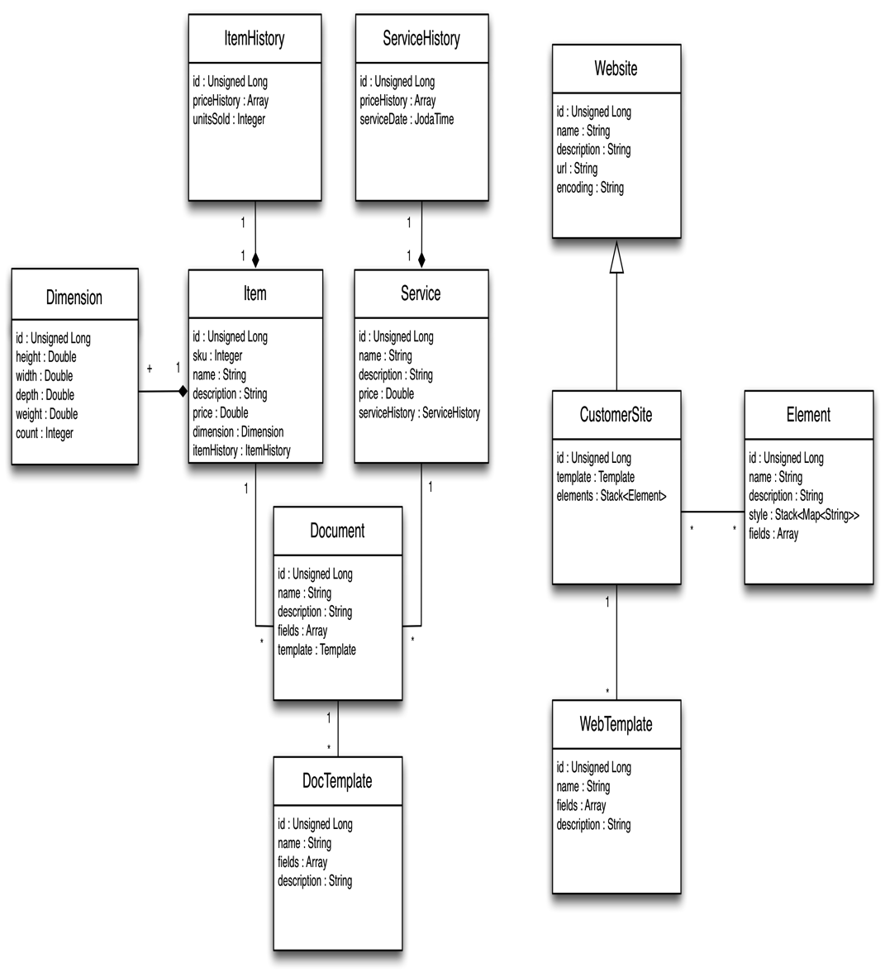
ShopLifter – Server Class Diagrams

Slide 7
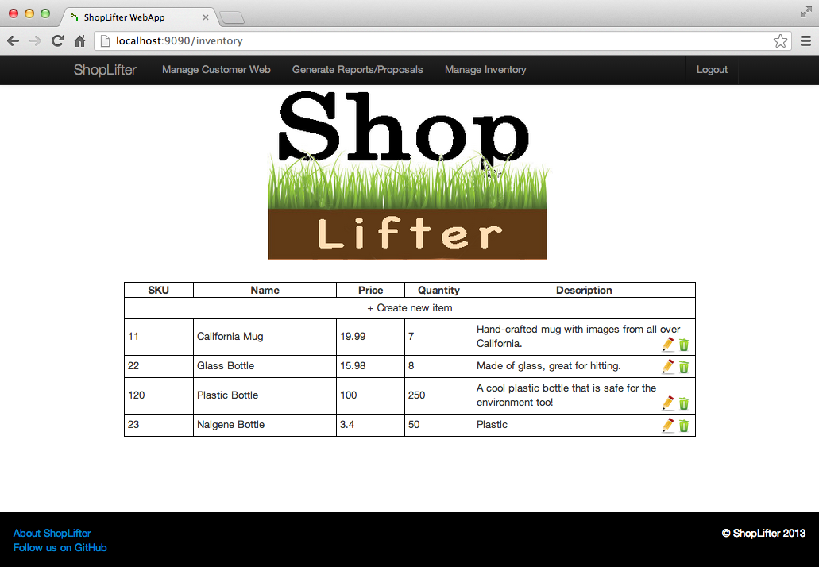
ShopLifter – User Interface

Slide 8
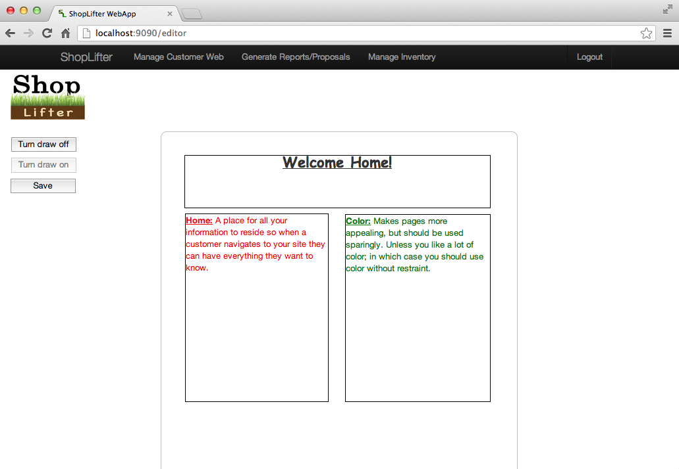
ShopLifter – User Interface

Slide 9
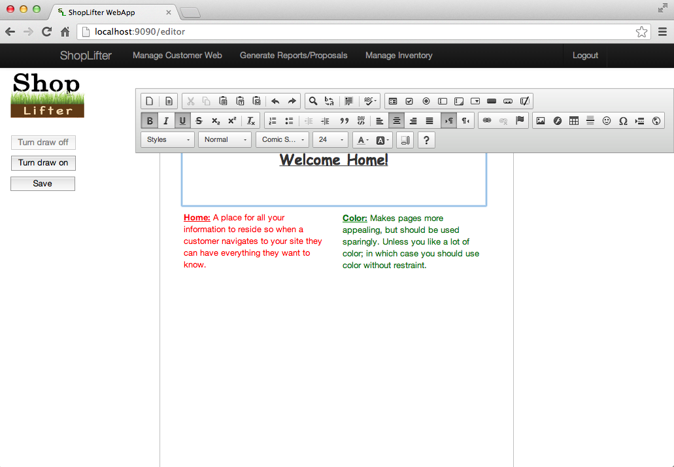
ShopLifter – User Interface

Slide 10
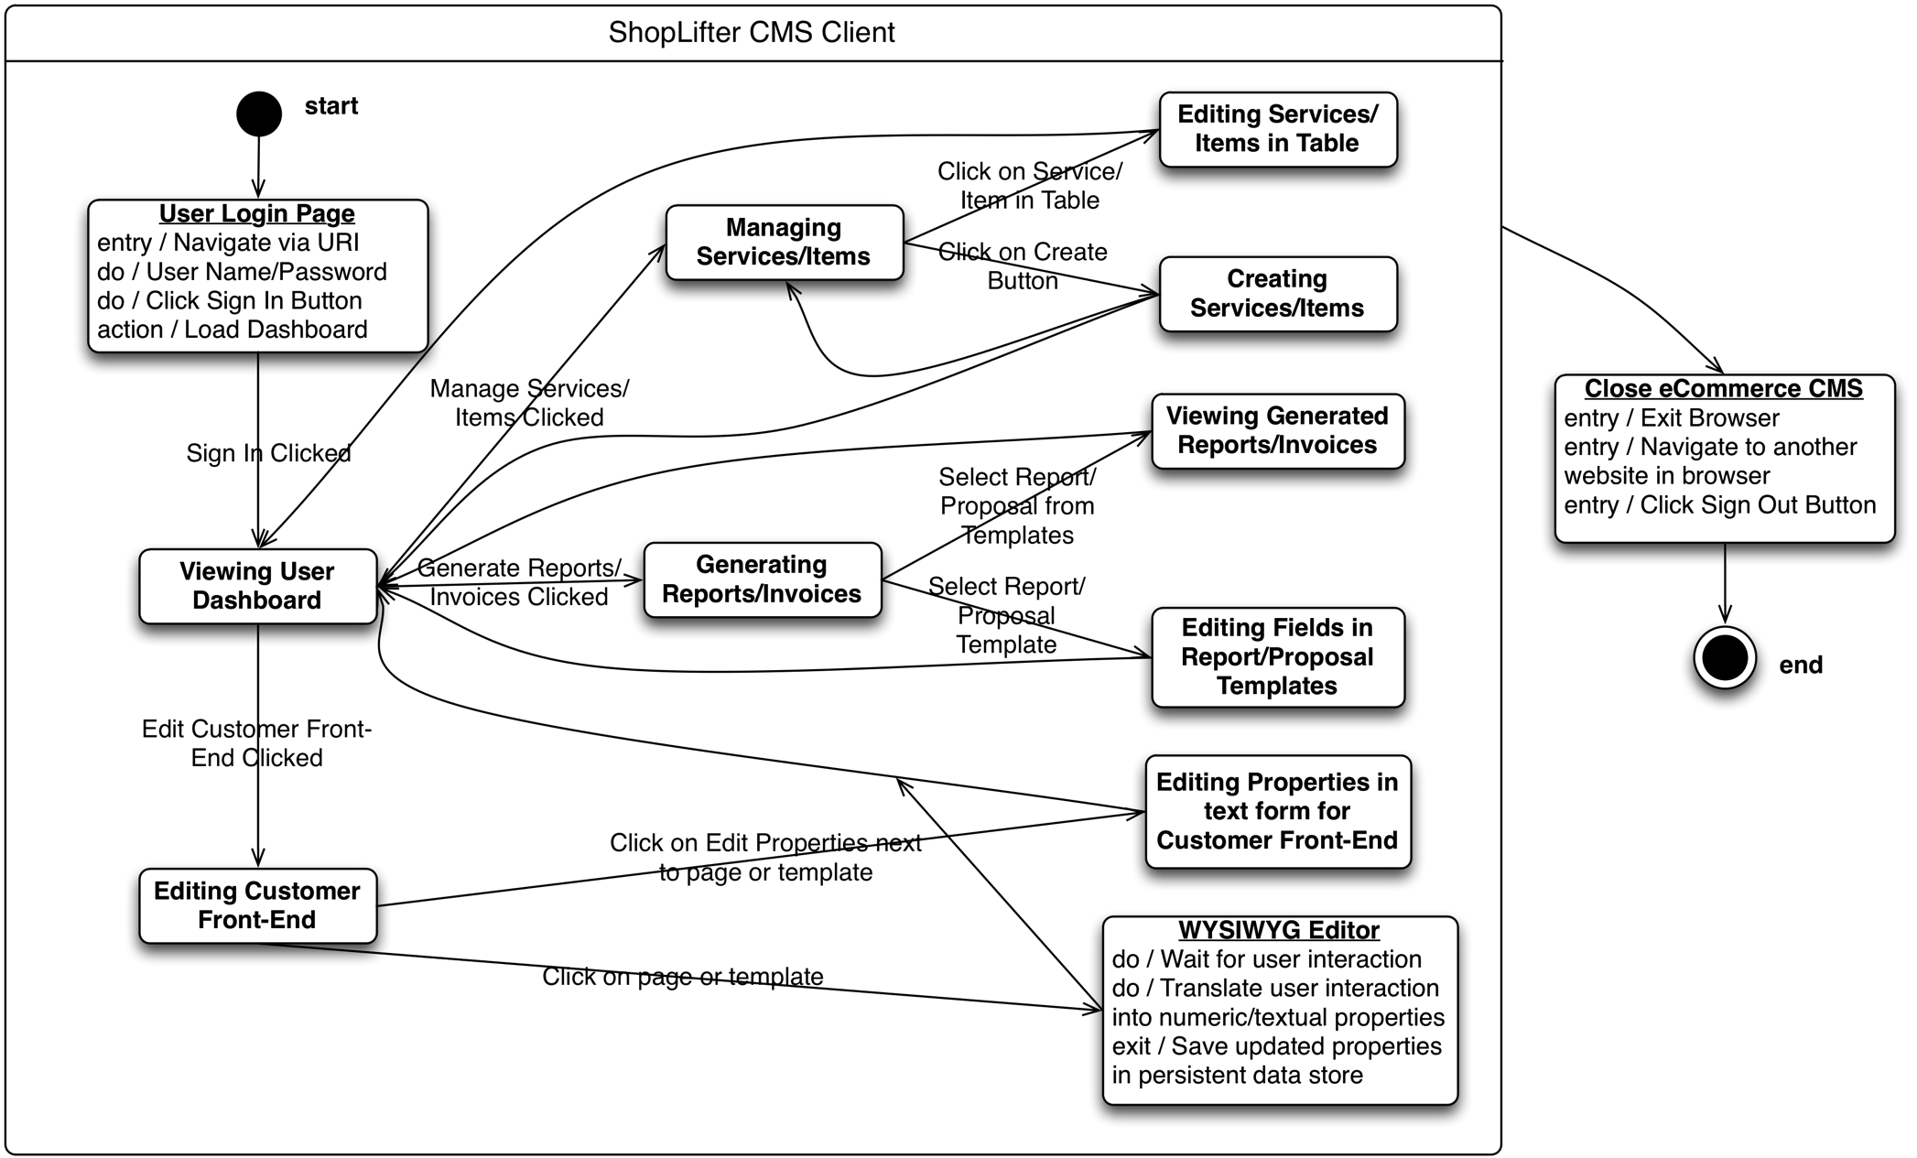
ShopLifter – State Diagram

Slide 11
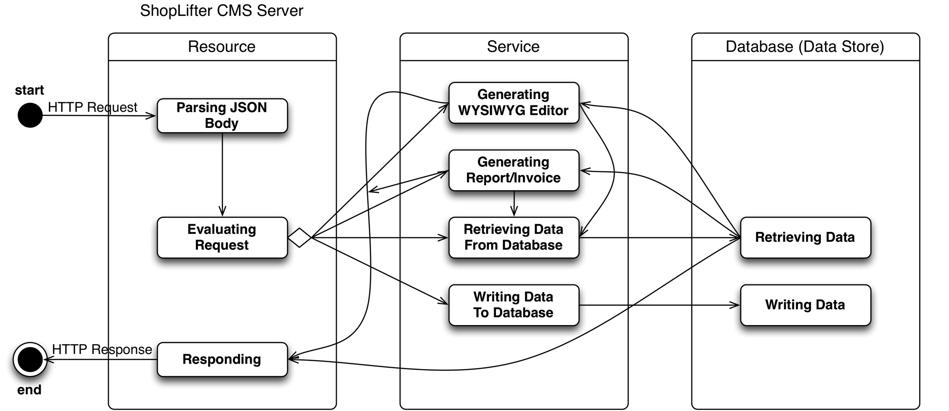
ShopLifter – State Diagram
Spring
JAX-RS
JAXB
Jackson
POJO
Hibernate
POJO
PostgreSQL

Slide 12
ShopLifter - Challenges
Project Scope
Breadth
Changing context
Technology Stack
Agnostic web service
Making estranged APIs friendly with one another
Troubleshooting
Integration project

Slide 13
ShopLifter - Questions
Any Questions?

